Slide 1
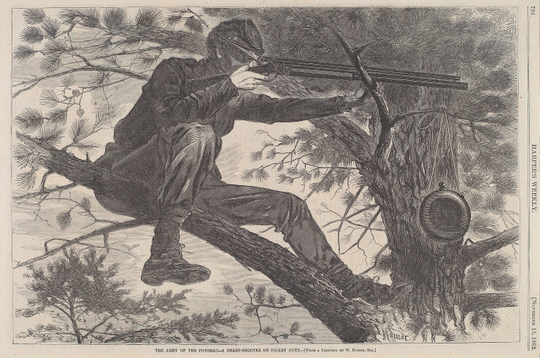
The Civil War and Representation

Slide 2
Questions for Consideration
How did writers and artists meet the challenges of the war?
What meanings did they give to the war? What available “languages of meaning” (such as Christian sacrifice or patriotism) did they draw upon?
Did writers and artists experience a “crisis of meaning” during the war?

Slide 3
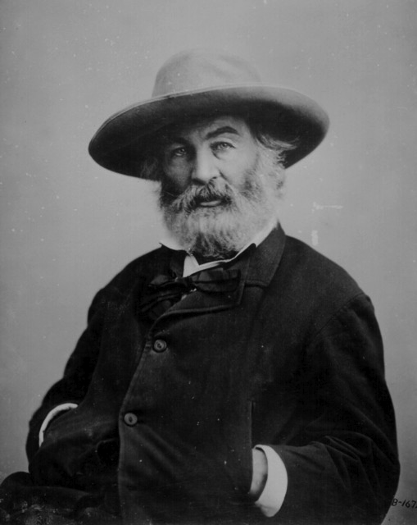
Walt Whitman
(1819-1892)

Slide 4
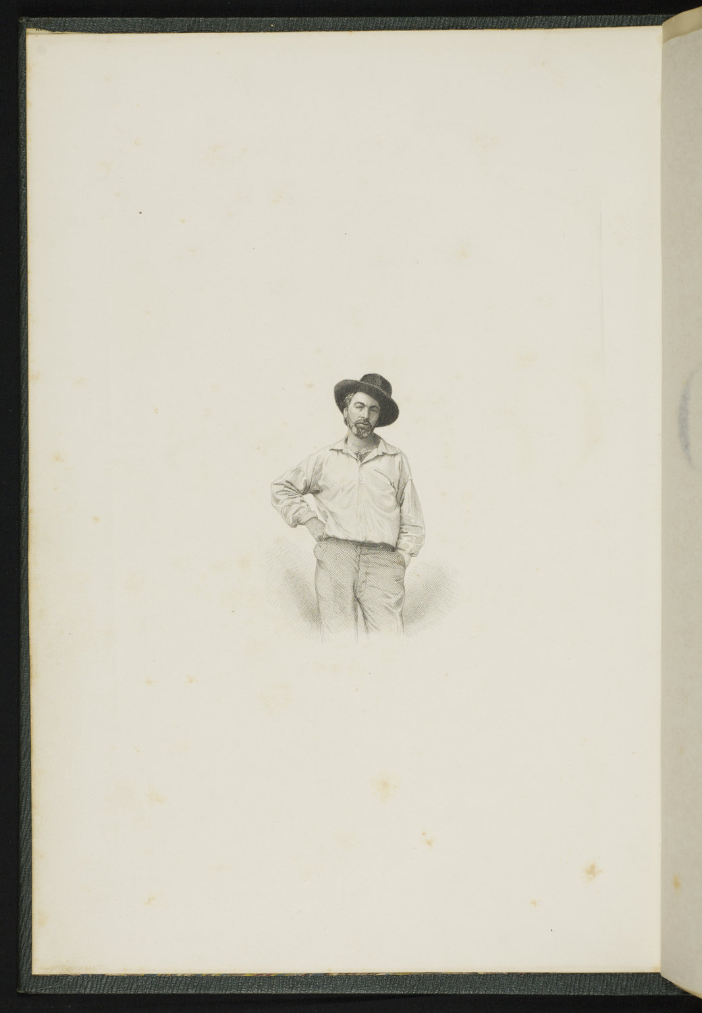
Leaves of Grass, 1855

Slide 5
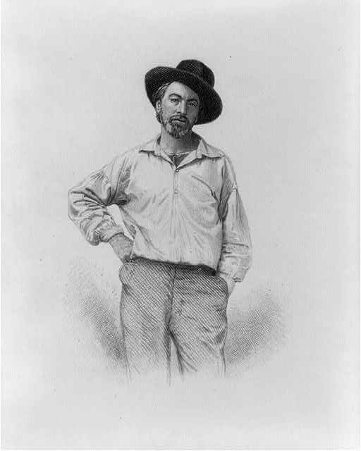

Slide 6
BEAT! BEAT! DRUMS!
Beat! beat! drums!—blow! bugles! blow!
Through the windows—through doors—burst like a ruthless force,
Into the solemn church, and scatter the congregation,
Into the school where the scholar is studying,
Leave not the bridegroom quiet—no happiness must he have now with his bride,
Nor the peaceful farmer any peace, ploughing his field or gathering his grain,
So fierce you whirr and pound you drums—so shrill you bugles blow.
Beat! beat! drums!—blow! bugles! blow!
Over the traffic of cities—over the rumble of wheels in the streets;
Are beds prepared for sleepers at night in the houses? no sleepers must sleep in those beds,
No bargainers’ bargains by day—no brokers or speculators—would they continue?
Would the talkers be talking? would the singer attempt to sing?
Would the lawyer rise in the court to state his case before the judge?
Then rattle quicker, heavier drums—you bugles wilder blow.
Beat! beat! drums!—blow! bugles! blow!
Make no parley—stop for no expostulation,
Mind not the timid—mind not the weeper or prayer,
Mind not the old man beseeching the young man,
Let not the child’s voice be heard, nor the mother’s entreaties,
Make even the trestles to shake the dead where they lie awaiting the hearses,
So strong you thump O terrible drums—so loud you bugles blow.

Slide 7
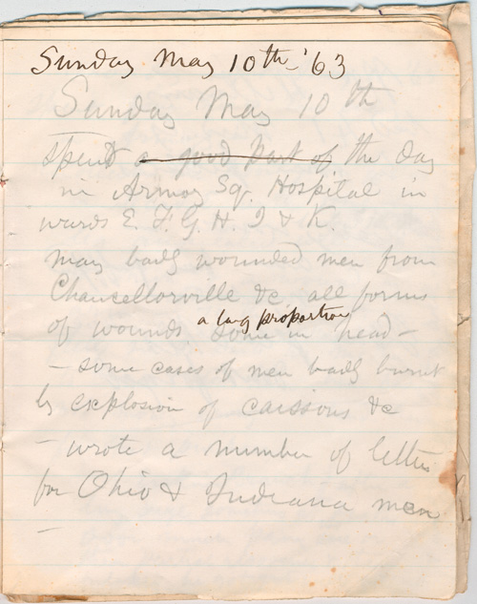
Whitman as hospital
visitor

Slide 8
Sunday May 10th—'63
Sunday May 10th
——— spendt a good part of the day the day in Armory Sq. Hospital in wards E. F. G. H. I & K. many badly wounded men from Chancellorville &c all forms of wounds, some ^{a large proportion} in head— —some cases of men badly burnt by explosion of caissons &c —wrote a number of letters for Ohio & Indiana men

Slide 9
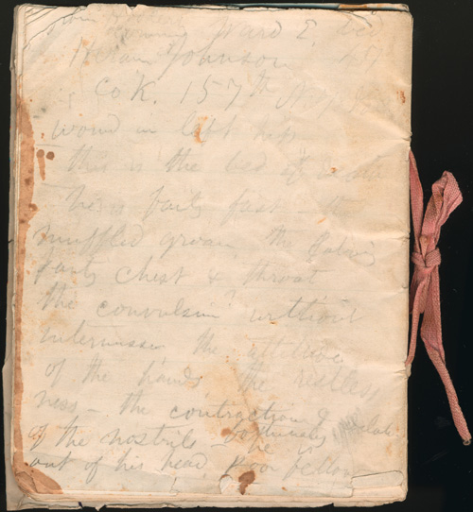

Slide 10
from Hookers command Ward E. bed 47 Hiram Johnson Co K. 157th N.Y. Vols wound in left hip ——— this is the bed of death ——— he is failing fast—the muffled groan, the laboring panting chest & throat, the convulsion without intermission, the attitude of the hands, the restlessness—the contraction & dilation of the nostrils—^{fortunately} he is out of his head, poor fellow

Slide 11
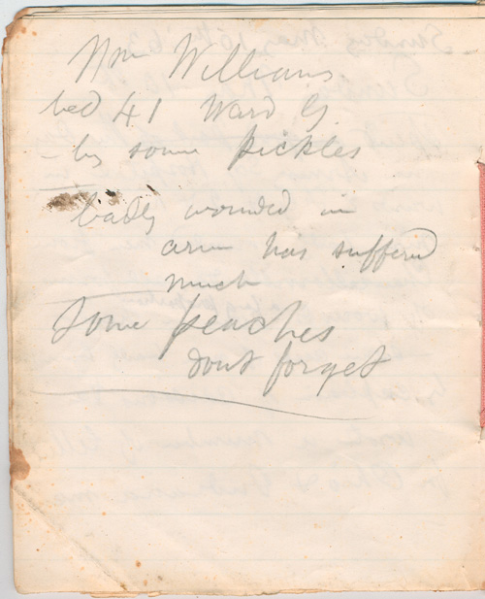

Slide 12
Wm Williams bed 41 Ward G. —bring some pickles ——— badly wounded in arm has suffered much ——— some peaches
dont forget ——————————

Slide 13
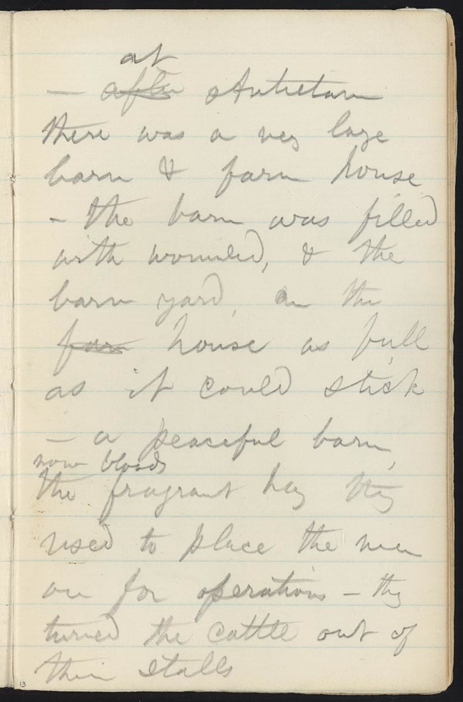
Walt Whitman's Civil War Diary—Thoughts on Antietam

Slide 14
Come Up from the Fields Father
Walt Whitman
Come up from the fields father, here’s a letter from our Pete,
And come to the front door mother, here’s a letter from thy dear son.
Lo, ’tis autumn,
Lo, where the trees, deeper green, yellower and redder,
Cool and sweeten Ohio’s villages with leaves fluttering in the moderate wind,
Where apples ripe in the orchards hang and grapes on the trellis’d vines,
(Smell you the smell of the grapes on the vines?
Smell you the buckwheat where the bees were lately buzzing?)
Above all, lo, the sky so calm, so transparent after the rain, and with wondrous clouds,
Below too, all calm, all vital and beautiful, and the farm prospers well.

Slide 15
Down in the fields all prospers well,
But now from the fields come father, come at the daughter’s call,
And come to the entry mother, to the front door come right away.
Fast as she can she hurries, something ominous, her steps trembling,
She does not tarry to smooth her hair nor adjust her cap.
Open the envelope quickly,
O this is not our son’s writing, yet his name is sign’d,
O a strange hand writes for our dear son, O stricken mother’s soul!
All swims before her eyes, flashes with black, she catches the main words only,
Sentences broken, gunshot wound in the breast, cavalry skirmish, taken to hospital,
At present low, but will soon be better.
Ah now the single figure to me,
Amid all teeming and wealthy Ohio with all its cities and farms,
Sickly white in the face and dull in the head, very faint,
By the jamb of a door leans.

Slide 16
Grieve not so, dear mother, (the just-grown daughter speaks through her sobs,
The little sisters huddle around speechless and dismay’d,)
See, dearest mother, the letter says Pete will soon be better.
Alas poor boy, he will never be better, (nor may-be needs to be better, that brave and simple soul,)
While they stand at home at the door he is dead already,
The only son is dead.
But the mother needs to be better,
She with thin form presently drest in black,
By day her meals untouch’d, then at night fitfully sleeping, often waking,
In the midnight waking, weeping, longing with one deep longing,
O that she might withdraw unnoticed, silent from life escape and withdraw,
To follow, to seek, to be with her dear dead son.

Slide 17
A SIGHT IN CAMP IN THE DAYBREAK GRAY AND DIM
A sight in camp in the daybreak gray and dim,
As from my tent I emerge so early sleepless,
As slow I walk in the cool fresh air the path near by the hospital tent,
Three forms I see on stretchers lying, brought out there untended lying,
Over each the blanket spread, ample brownish woolen blanket,
Gray and heavy blanket, folding, covering all.
Curious I halt and silent stand,
Then with light fingers I from the face of the nearest the first just lift the blanket;
Who are you elderly man so gaunt and grim, with well-gray’d hair, and flesh all sunken about the eyes?
Who are you my dear comrade?
Then to the second I step—and who are you my child and darling?
Who are you sweet boy with cheeks yet blooming?
Then to the third—a face nor child nor old, very calm, as of beautiful yellow-white ivory;
Young man I think I know you—I think this face is the face of the Christ himself,
Dead and divine and brother of all, and here again he lies.

Slide 18
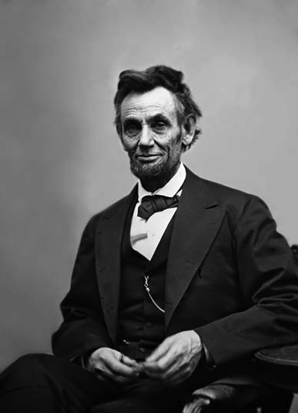
Lincoln in 1865

Slide 19
"During the drive he was so gay, that I said to him, laughingly, 'Dear husband, you almost startled me by your great cheerfulness,' he replied, 'and well I may feel so, Mary, I consider this day, the war, has come to a close'—and then added 'We must both, be more cheerful in the future—between the war and the loss of our darling Willie—we have both, been very miserable.'”
—Mary Lincoln recounting the carriage ride they took the afternoon before attending Ford’s Theatre on April 14th, 1865

Slide 20
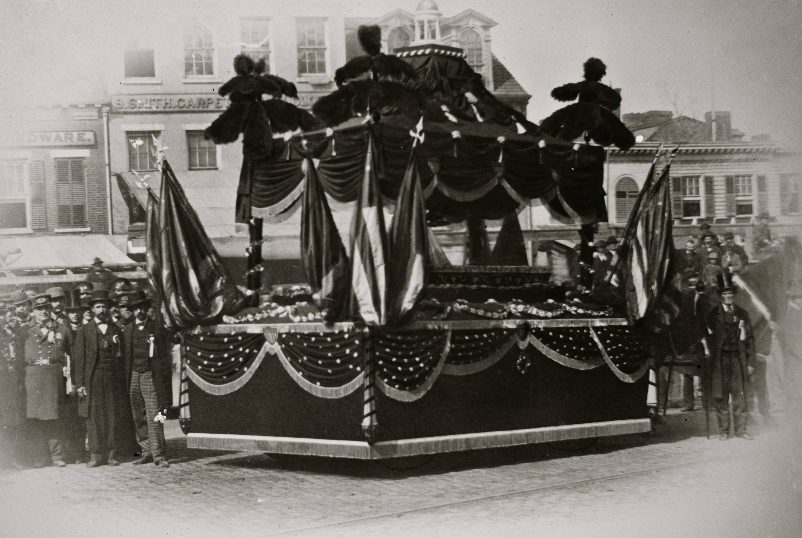

Slide 21
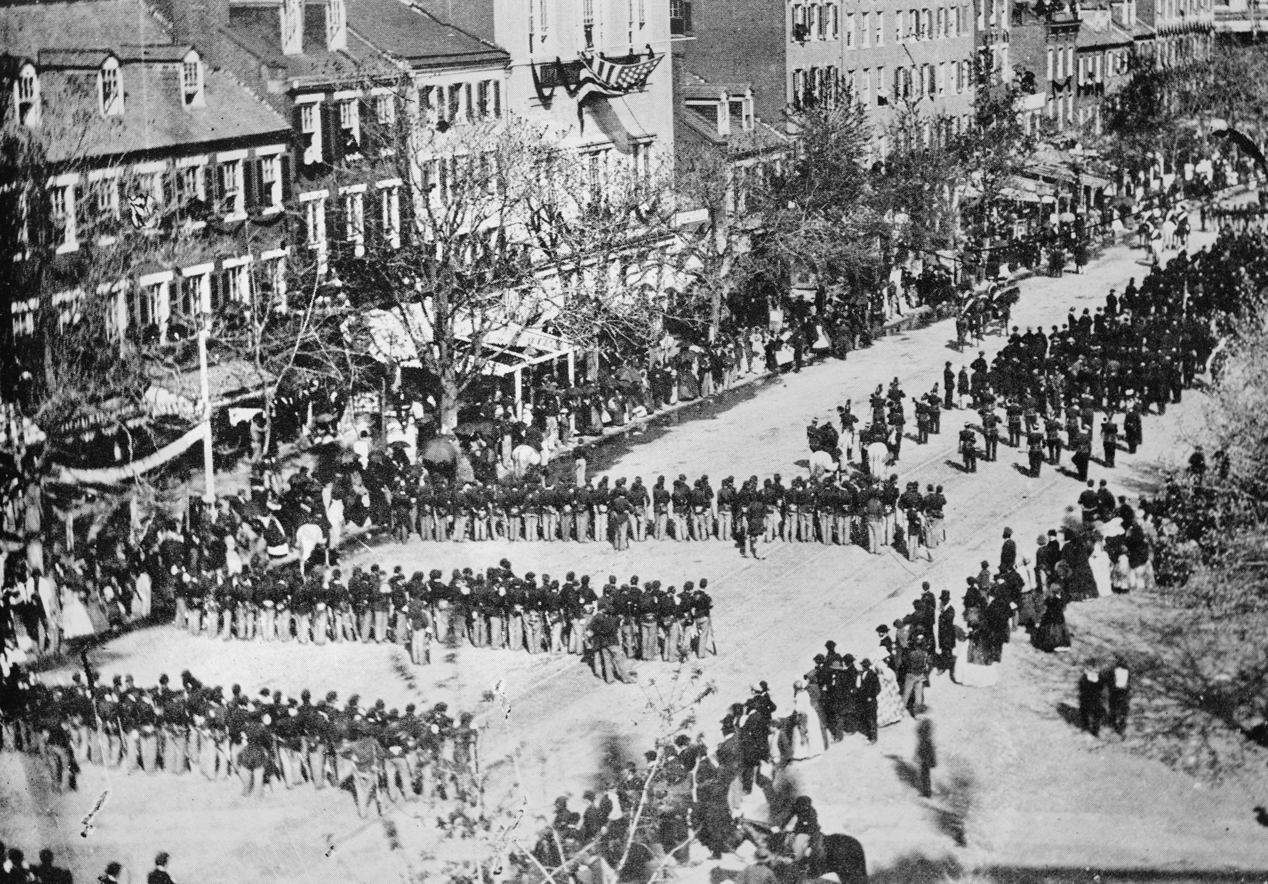
Lincoln’s Funeral, Pennsylvania Avenue

Slide 22
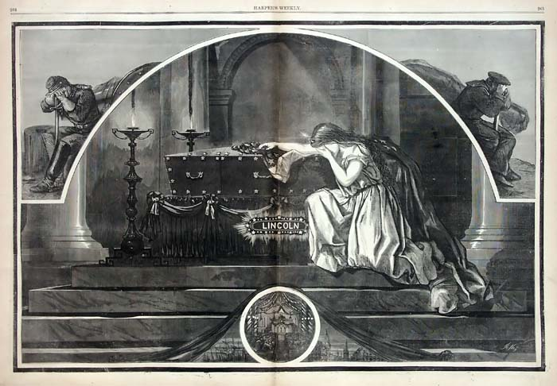

Slide 23
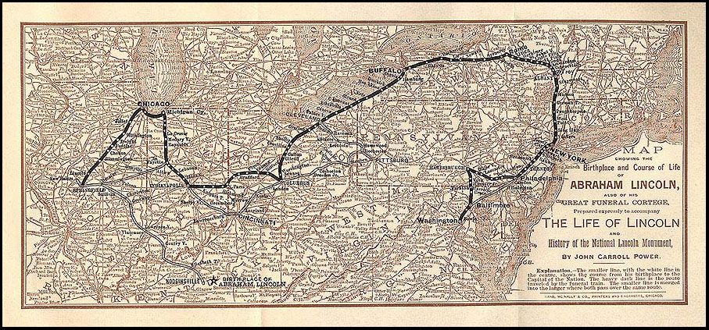

Slide 24
O Captain! My Captain!
O Captain! my Captain! our fearful trip is done,
The ship has weather’d every rack, the prize we sought is won,
The port is near, the bells I hear, the people all exulting,
While follow eyes the steady keel, the vessel grim and daring;
But O heart! heart! heart!
O the bleeding drops of red,
Where on the deck my Captain lies,
Fallen cold and dead.
O Captain! my Captain! rise up and hear the bells;
Rise up—for you the flag is flung—for you the bugle trills,
For you bouquets and ribbon’d wreaths—for you the shores a-crowding,
For you they call, the swaying mass, their eager faces turning;
Here Captain! dear father!
The arm beneath your head!
It is some dream that on the deck,
You’ve fallen cold and dead.

Slide 25
My Captain does not answer, his lips are pale and still,
My father does not feel my arm, he has no pulse nor will,
The ship is anchor’d safe and sound, its voyage closed and done,
From fearful trip the victor ship comes in with object won;
Exult O shores, and ring O bells!
But I with mournful tread,
Walk the deck my Captain lies,
Fallen cold and dead.

Slide 26
When Lilacs Last in the Dooryard Bloom’d
1
When lilacs last in the dooryard bloom’d,
And the great star early droop’d in the western sky in the night,
I mourn’d, and yet shall mourn with ever-returning spring.
Ever-returning spring, trinity sure to me you bring,
Lilac blooming perennial and drooping star in the west,
And thought of him I love.
2
O powerful western fallen star!
O shades of night—O moody, tearful night!
O great star disappear’d—O the black murk that hides the star!
O cruel hands that hold me powerless—O helpless soul of me!
O harsh surrounding cloud that will not free my soul.
3
In the dooryard fronting an old farm-house near the white-wash’d palings,
Stands the lilac-bush tall-growing with heart-shaped leaves of rich green,
With many a pointed blossom rising delicate, with the perfume strong I love,
With every leaf a miracle—and from this bush in the dooryard,
With delicate-color’d blossoms and heart-shaped leaves of rich green,
A sprig with its flower I break.

Slide 27
4
In the swamp in secluded recesses,
A shy and hidden bird is warbling a song.
Solitary the thrush,
The hermit withdrawn to himself, avoiding the settlements,
Sings by himself a song.
Song of the bleeding throat,
Death’s outlet song of life, (for well dear brother I know,
If thou wast not granted to sing thou would’st surely die.)
5
Over the breast of the spring, the land, amid cities,
Amid lanes and through old woods, where lately the violets peep’d from the ground, spotting the gray debris,
Amid the grass in the fields each side of the lanes, passing the endless grass,
Passing the yellow-spear’d wheat, every grain from its shroud in the dark-brown fields uprisen,
Passing the apple-tree blows of white and pink in the orchards,
Carrying a corpse to where it shall rest in the grave,
Night and day journeys a coffin.

Slide 28
6
Coffin that passes through lanes and streets,
Through day and night with the great cloud darkening the land,
With the pomp of the inloop’d flags with the cities draped in black,
With the show of the States themselves as of crape-veil’d women standing,
With processions long and winding and the flambeaus of the night,
With the countless torches lit, with the silent sea of faces and the unbared heads,
With the waiting depot, the arriving coffin, and the sombre faces,
With dirges through the night, with the thousand voices rising strong and solemn,
With all the mournful voices of the dirges pour’d around the coffin,
The dim-lit churches and the shuddering organs—where amid these you journey,
With the tolling tolling bells’ perpetual clang,
Here, coffin that slowly passes,
I give you my sprig of lilac.
7
(Nor for you, for one alone,
Blossoms and branches green to coffins all I bring,
For fresh as the morning, thus would I chant a song for you O sane and sacred death.
All over bouquets of roses,
O death, I cover you over with roses and early lilies,
But mostly and now the lilac that blooms the first,
Copious I break, I break the sprigs from the bushes,
With loaded arms I come, pouring for you,
For you and the coffins all of you O death.)

Slide 29
8
O western orb sailing the heaven,
Now I know what you must have meant as a month since I walk’d,
As I walk’d in silence the transparent shadowy night,
As I saw you had something to tell as you bent to me night after night,
As you droop’d from the sky low down as if to my side, (while the other stars all look’d on,)
As we wander’d together the solemn night, (for something I know not what kept me from sleep,)
As the night advanced, and I saw on the rim of the west how full you were of woe,
As I stood on the rising ground in the breeze in the cool transparent night,
As I watch’d where you pass’d and was lost in the netherward black of the night,
As my soul in its trouble dissatisfied sank, as where you sad orb,
Concluded, dropt in the night, and was gone.

Slide 30
9
Sing on there in the swamp,
O singer bashful and tender, I hear your notes, I hear your call,
I hear, I come presently, I understand you,
But a moment I linger, for the lustrous star has detain’d me,
The star my departing comrade holds and detains me.
10
O how shall I warble myself for the dead one there I loved?
And how shall I deck my song for the large sweet soul that has gone?
And what shall my perfume be for the grave of him I love?
Sea-winds blown from east and west,
Blown from the Eastern sea and blown from the Western sea, till there on the prairies meeting,
These and with these and the breath of my chant,
I’ll perfume the grave of him I love.

Slide 31
11
O what shall I hang on the chamber walls?
And what shall the pictures be that I hang on the walls,
To adorn the burial-house of him I love?
Pictures of growing spring and farms and homes,
With the Fourth-month eve at sundown, and the gray smoke lucid and bright,
With floods of the yellow gold of the gorgeous, indolent, sinking sun, burning, expanding the air,
With the fresh sweet herbage under foot, and the pale green leaves of the trees prolific,
In the distance the flowing glaze, the breast of the river, with a wind-dapple here and there,
With ranging hills on the banks, with many a line against the sky, and shadows,
And the city at hand with dwellings so dense, and stacks of chimneys,
And all the scenes of life and the workshops, and the workmen homeward returning.

Slide 32
12
Lo, body and soul—this land,
My own Manhattan with spires, and the sparkling and hurrying tides, and the ships,
The varied and ample land, the South and the North in the light, Ohio’s shores and flashing Missouri,
And ever the far-spreading prairies cover’d with grass and corn.
Lo, the most excellent sun so calm and haughty,
The violet and purple morn with just-felt breezes,
The gentle soft-born measureless light,
The miracle spreading bathing all, the fulfill’d noon,
The coming eve delicious, the welcome night and the stars,
Over my cities shining all, enveloping man and land.

Slide 33
13
Sing on, sing on you gray-brown bird,
Sing from the swamps, the recesses, pour your chant from the bushes,
Limitless out of the dusk, out of the cedars and pines.
Sing on dearest brother, warble your reedy song,
Loud human song, with voice of uttermost woe.
O liquid and free and tender!
O wild and loose to my soul—O wondrous singer!
You only I hear—yet the star holds me, (but will soon depart,)
Yet the lilac with mastering odor holds me.

Slide 34
14
Now while I sat in the day and look’d forth,
In the close of the day with its light and the fields of spring, and the farmers preparing their crops,
In the large unconscious scenery of my land with its lakes and forests,
In the heavenly aerial beauty, (after the perturb’d winds and the storms,)
Under the arching heavens of the afternoon swift passing, and the voices of children and women,
The many-moving sea-tides, and I saw the ships how they sail’d,
And the summer approaching with richness, and the fields all busy with labor,
And the infinite separate houses, how they all went on, each with its meals and minutia of daily usages,
And the streets how their throbbings throbb’d, and the cities pent—lo, then and there,
Falling upon them all and among them all, enveloping me with the rest,
Appear’d the cloud, appear’d the long black trail,
And I knew death, its thought, and the sacred knowledge of death.
Then with the knowledge of death as walking one side of me,
And the thought of death close-walking the other side of me,
And I in the middle as with companions, and as holding the hands of companions,
I fled forth to the hiding receiving night that talks not,
Down to the shores of the water, the path by the swamp in the dimness,
To the solemn shadowy cedars and ghostly pines so still.

Slide 35
And the singer so shy to the rest receiv’d me,
The gray-brown bird I know receiv’d us comrades three,
And he sang the carol of death, and a verse for him I love.
From deep secluded recesses,
From the fragrant cedars and the ghostly pines so still,
Came the carol of the bird.
And the charm of the carol rapt me,
As I held as if by their hands my comrades in the night,
And the voice of my spirit tallied the song of the bird.
Come lovely and soothing death,
Undulate round the world, serenely arriving, arriving,
In the day, in the night, to all, to each,
Sooner or later delicate death.

Slide 36
Prais’d be the fathomless universe,
For life and joy, and for objects and knowledge curious,
And for love, sweet love—but praise! praise! praise!
For the sure-enwinding arms of cool-enfolding death.
Dark mother always gliding near with soft feet,
Have none chanted for thee a chant of fullest welcome?
Then I chant it for thee, I glorify thee above all,
I bring thee a song that when thou must indeed come, come unfalteringly.
Approach strong deliveress,
When it is so, when thou hast taken them I joyously sing the dead,
Lost in the loving floating ocean of thee,
Laved in the flood of thy bliss O death.

Slide 37
From me to thee glad serenades,
Dances for thee I propose saluting thee, adornments and feastings for thee,
And the sights of the open landscape and the high-spread sky are fitting,
And life and the fields, and the huge and thoughtful night.
The night in silence under many a star,
The ocean shore and the husky whispering wave whose voice I know,
And the soul turning to thee O vast and well-veil’d death,
And the body gratefully nestling close to thee.
Over the tree-tops I float thee a song,
Over the rising and sinking waves, over the myriad fields and the prairies wide,
Over the dense-pack’d cities all and the teeming wharves and ways,
I float this carol with joy, with joy to thee O death.

Slide 38
15
To the tally of my soul,
Loud and strong kept up the gray-brown bird,
With pure deliberate notes spreading filling the night.
Loud in the pines and cedars dim,
Clear in the freshness moist and the swamp-perfume,
And I with my comrades there in the night.
While my sight that was bound in my eyes unclosed,
As to long panoramas of visions.
And I saw askant the armies,
I saw as in noiseless dreams hundreds of battle-flags,
Borne through the smoke of the battles and pierc’d with missiles I saw them,
And carried hither and yon through the smoke, and torn and bloody,
And at last but a few shreds left on the staffs, (and all in silence,)
And the staffs all splinter’d and broken.
I saw battle-corpses, myriads of them,
And the white skeletons of young men, I saw them,
I saw the debris and debris of all the slain soldiers of the war,
But I saw they were not as was thought,
They themselves were fully at rest, they suffer’d not,
The living remain’d and suffer’d, the mother suffer’d,
And the wife and the child and the musing comrade suffer’d,
And the armies that remain’d suffer’d.

Slide 39
16
Passing the visions, passing the night,
Passing, unloosing the hold of my comrades’ hands,
Passing the song of the hermit bird and the tallying song of my soul,
Victorious song, death’s outlet song, yet varying ever-altering song,
As low and wailing, yet clear the notes, rising and falling, flooding the night,
Sadly sinking and fainting, as warning and warning, and yet again bursting with joy,
Covering the earth and filling the spread of the heaven,
As that powerful psalm in the night I heard from recesses,
Passing, I leave thee lilac with heart-shaped leaves,
I leave thee there in the door-yard, blooming, returning with spring.
I cease from my song for thee,
From my gaze on thee in the west, fronting the west, communing with thee,
O comrade lustrous with silver face in the night.
Yet each to keep and all, retrievements out of the night,
The song, the wondrous chant of the gray-brown bird,
And the tallying chant, the echo arous’d in my soul,
With the lustrous and drooping star with the countenance full of woe,
With the holders holding my hand nearing the call of the bird,
Comrades mine and I in the midst, and their memory ever to keep, for the dead I loved so well,
For the sweetest, wisest soul of all my days and lands—and this for his dear sake,
Lilac and star and bird twined with the chant of my soul,
There in the fragrant pines and the cedars dusk and dim.

Slide 40
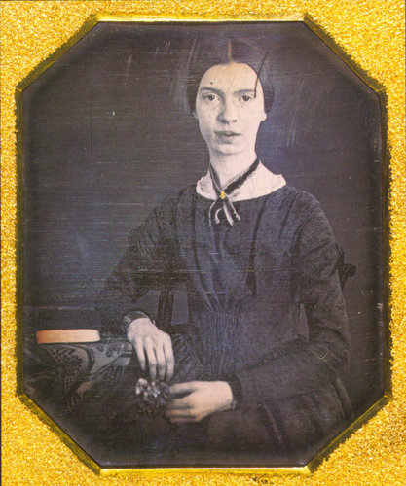
Emily Dickinson
(1830-1886)

Slide 41
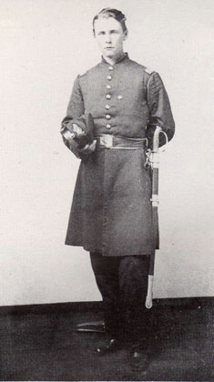
Frazer Stearns

Slide 42
My Triumph lasted till the Drums
1227 My Triumph lasted till the Drums Had left the Dead alone And then I dropped my Victory And chastened stole along To where the finished Faces Conclusion turned on me And then I hated Glory And wished myself were They. What is to be is best descried When it has also been— Could Prospect taste of Retrospect The tyrannies of Men Were Tenderer—diviner The Transitive toward. A Bayonet’s contrition Is nothing to the Dead.

Slide 43
My Portion is Defeat—today
639 My Portion is Defeat—today— A paler luck than Victory— Less Paeans—fewer Bells— The Drums don't follow Me—with tunes— Defeat—a somewhat slower—means— More Arduous than Balls— 'Tis populous with Bone and stain— And Men too straight to stoop again—, And Piles of solid Moan— And Chips of Blank—in Boyish Eyes— And scraps of Prayer— And Death's surprise, Stamped visible—in Stone— There's somewhat prouder, over there— The Trumpets tell it to the Air— How different Victory To Him who has it—and the One Who to have had it, would have been Contender—to die—

Slide 44
The Battle fought between the Soul
594 The Battle fought between the Soul And No Man—is the One Of all the Battles prevalent— By far the Greater One— No News of it is had abroad— Its Bodiless Campaign Establishes, and terminates— Invisible—Unknown Nor History—record it— As Legions of a Night The Sunrise scatters—These endure— Enact—and terminate—

Slide 45
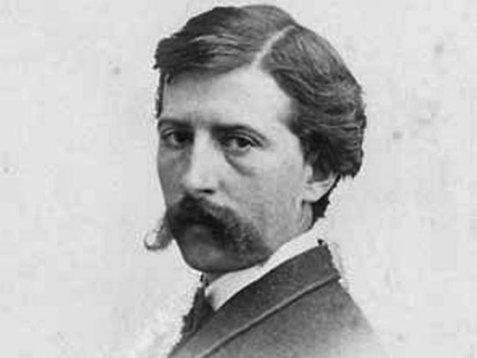
Winslow Homer in 1863
(1836-1910)

Slide 46
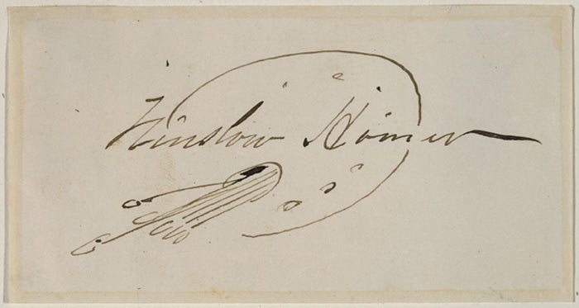

Slide 47
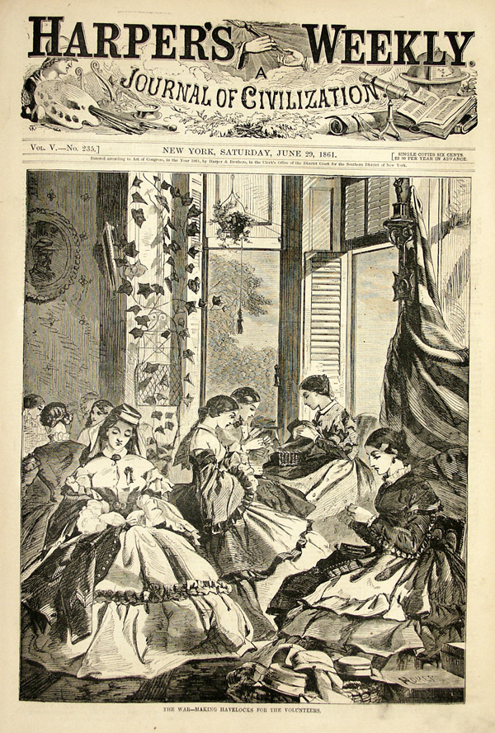
"The War--Making Havelocks for the Volunteers," Winslow Homer in Harper's Weekly, June 29, 1861

Slide 48
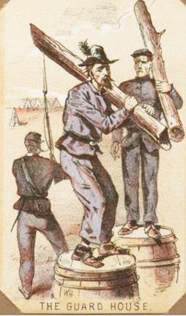
Winslow Homer, "The Guard House," from Life in Camp Cards

Slide 49
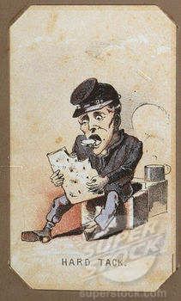
Winslow Homer, "Hard Tack," from Life in Camp Cards

Slide 50
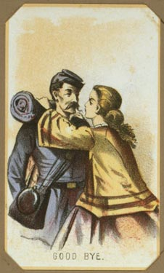
Winslow Homer, "Good Bye," from Life in Camp Cards

Slide 51
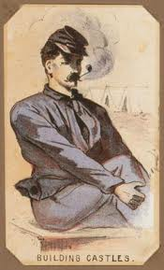
Winslow Homer, "Building Castles," from Life in Camp Cards

Slide 52
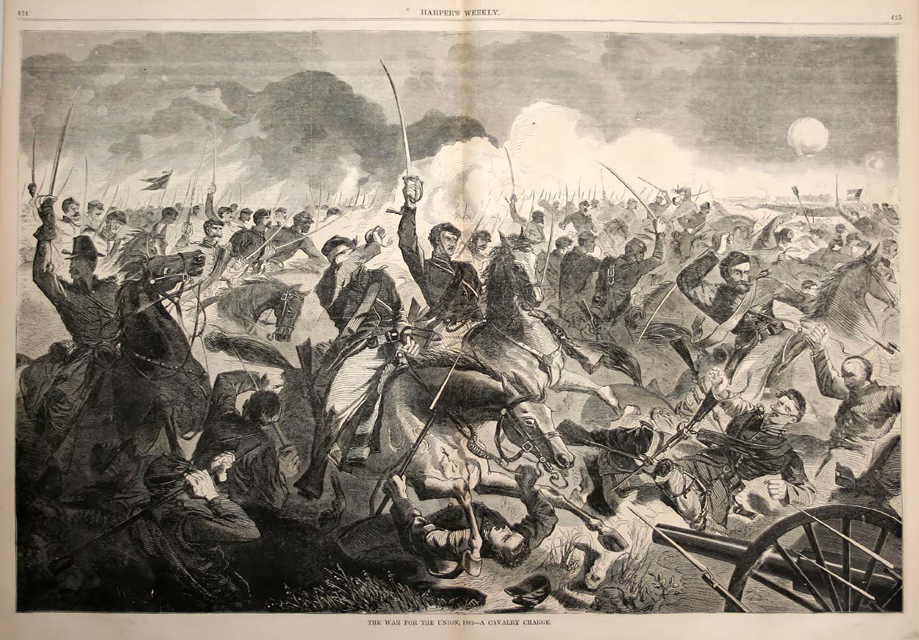
Winslow Homer, "The War for the Union, 1862--A Cavalry Charge," Harper's Weekly

Slide 53
Winslow Homer, "The Army of the Potomac--A Sharp Shooter on Picket Duty," Harper's Weekly, November 15, 1862

Slide 54
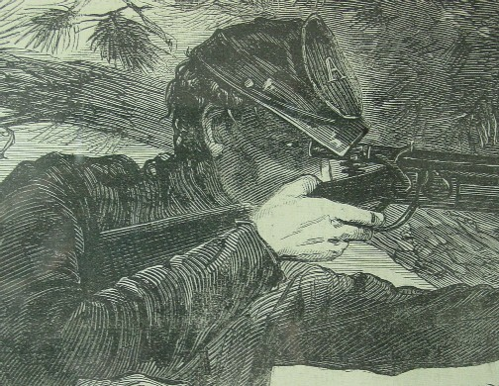
Detail, "A Sharp Shooter on Picket Duty"

Slide 55
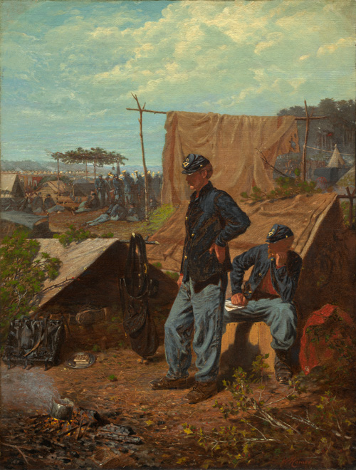
Home, Sweet Home
Winslow Homer, 1863

Slide 56
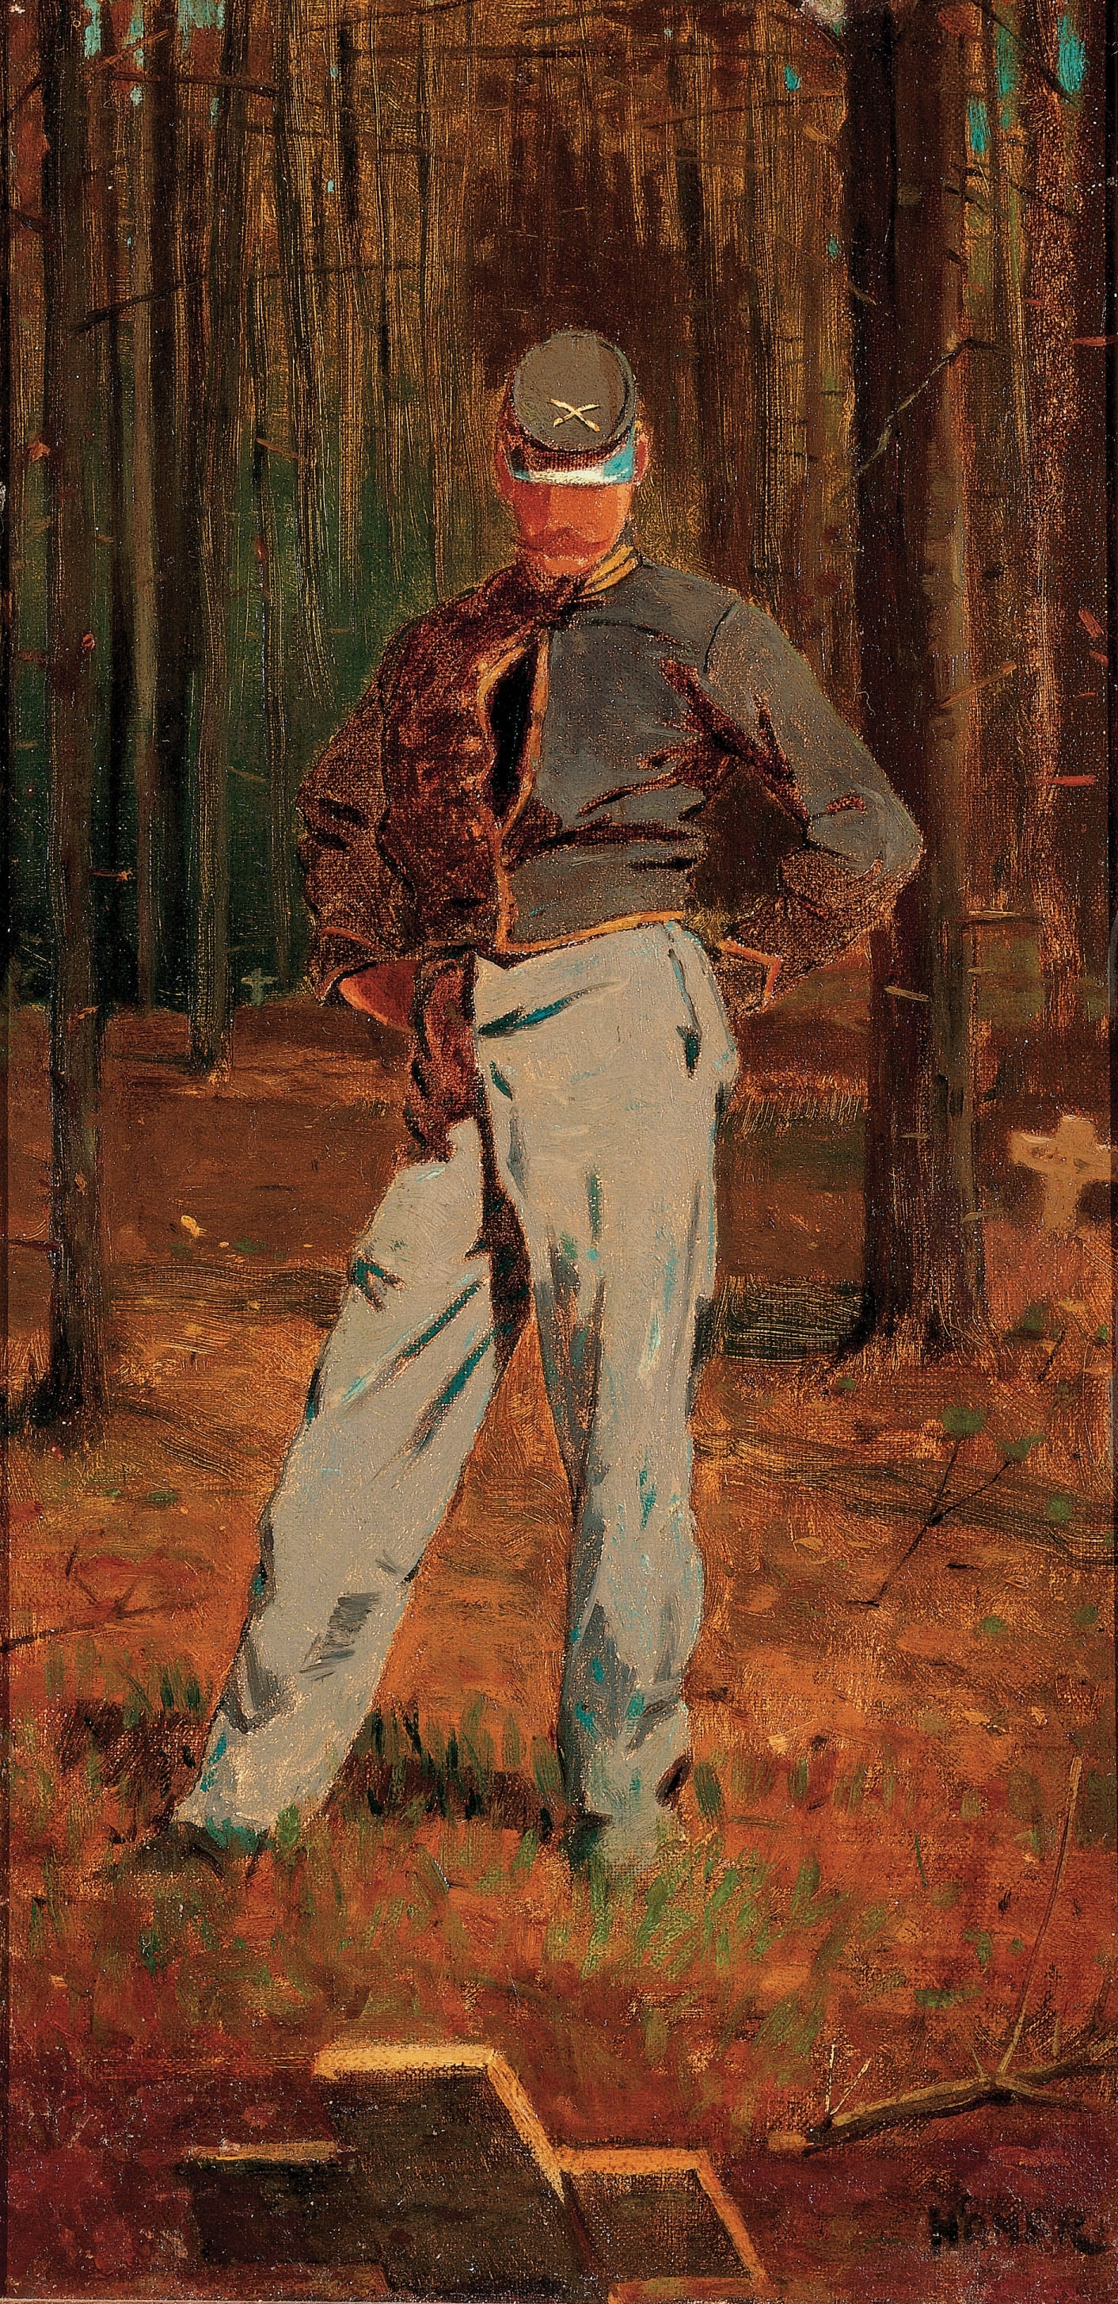
Trooper Meditating Beside a Grave
Winslow Homer, 1865

Slide 57
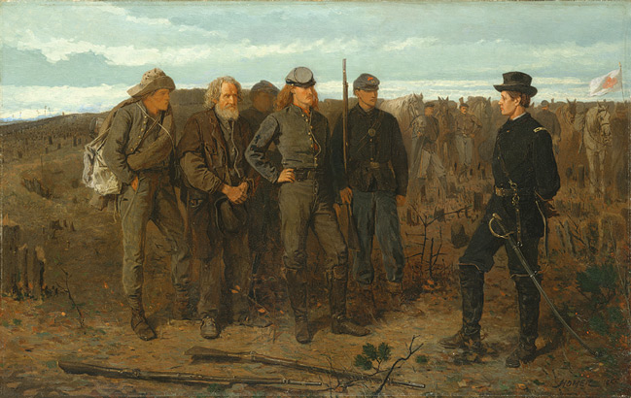
Winslow Homer, Prisoners from the Front, 1866

Slide 58
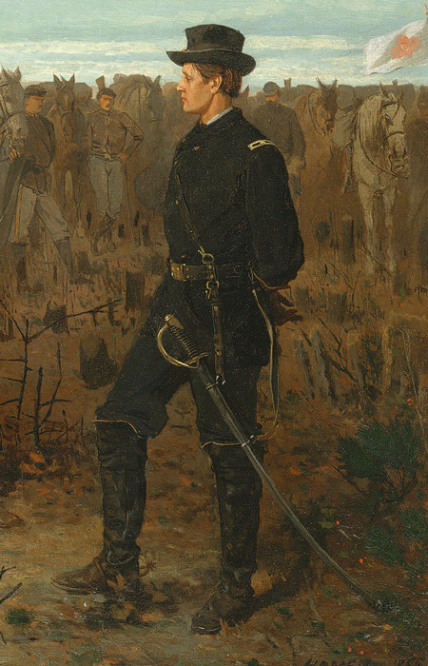
Brigadier General Francis Channing Barlow

Slide 59
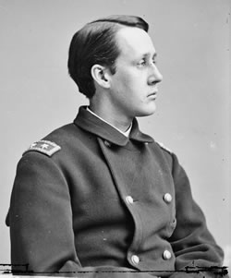
General Barlow

Slide 60
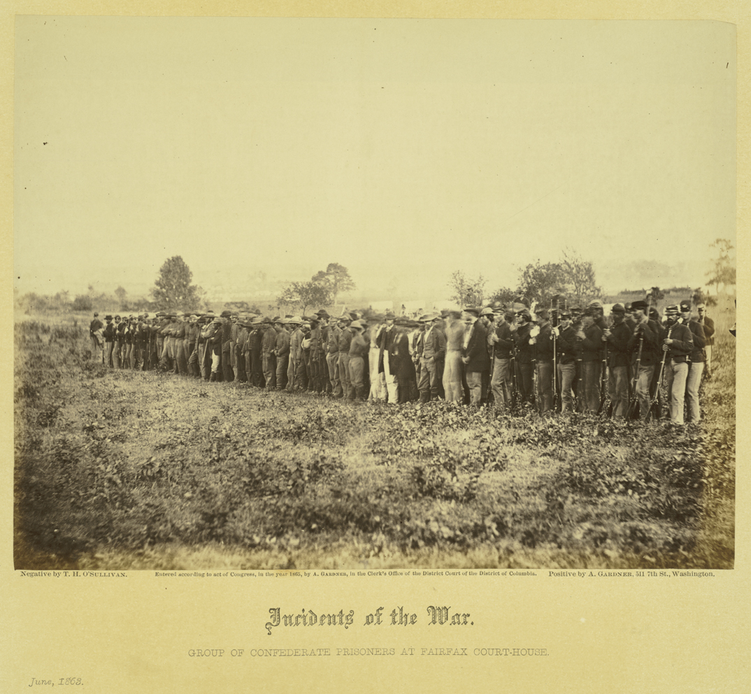
"Group of Confederate Prisoners at Fairfax Courthouse," June 1863, from Alexander Gardner, Incidents of the War

Slide 62
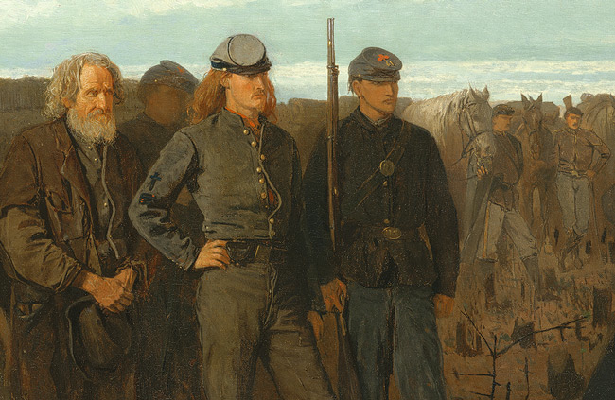
Detail, Prisoners from the Front

Slide 63
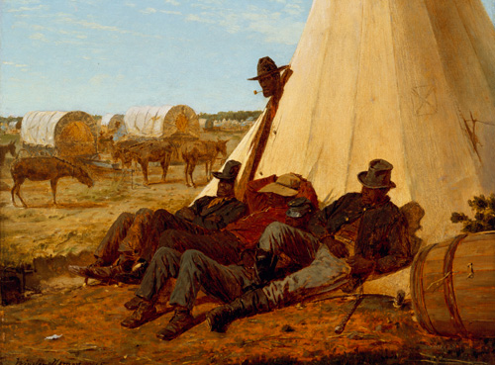
The Bright Side
Winslow Homer,
1865

Slide 64
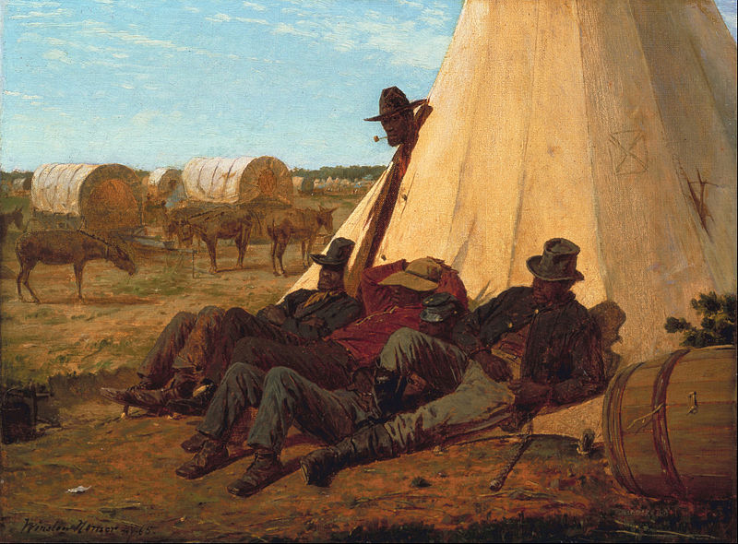
Notes:
The Bright Side, 1865. “Men of rangy dignity, defying any objectifying gaze.”

Slide 65
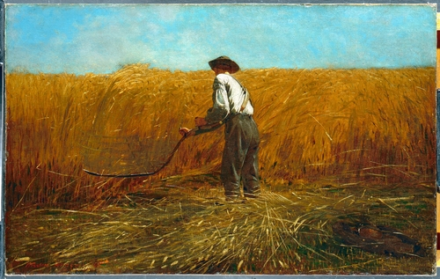
Winslow Homer, The Veteran in a New Field, 1866

Slide 66
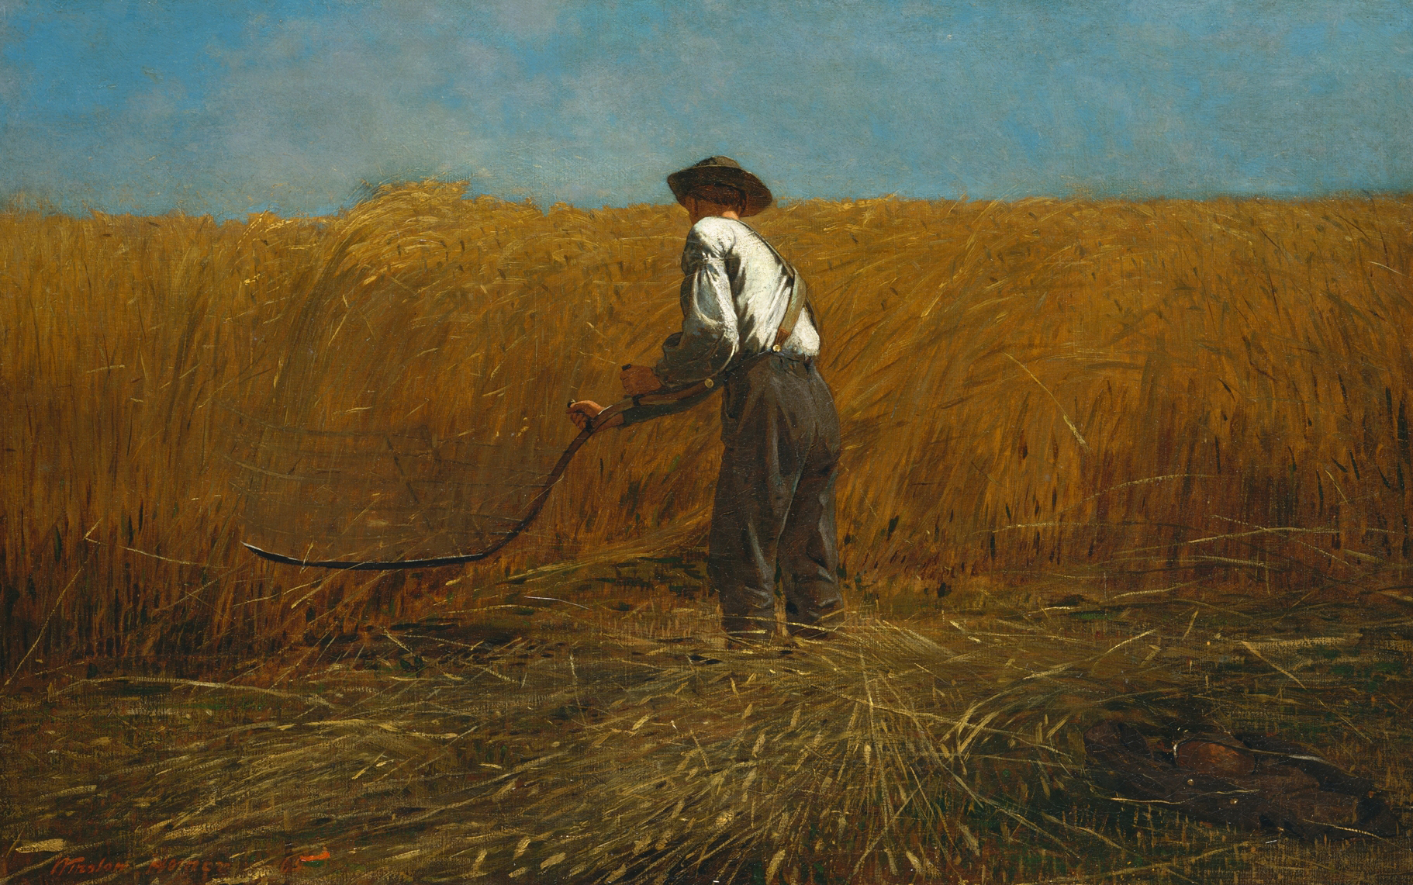

Slide 67
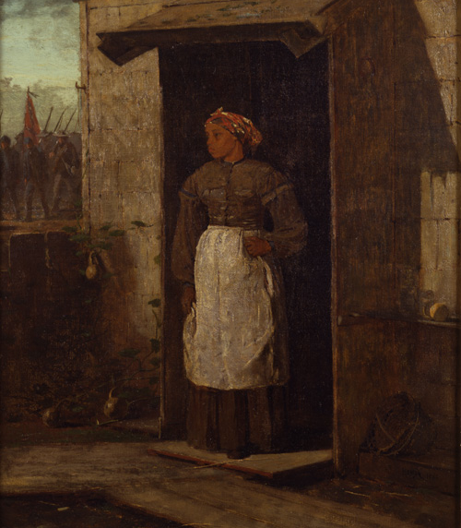
Near Andersonville
Winslow Homer, 1865-1866

Slide 68
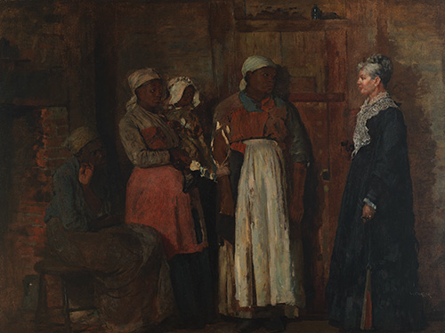
A Visit from the Old Mistress
Winslow Homer, 1876

Slide 69
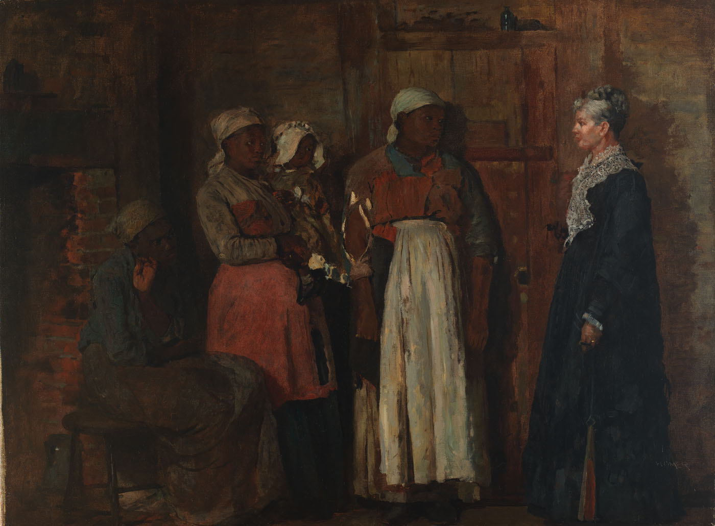

Slide 70
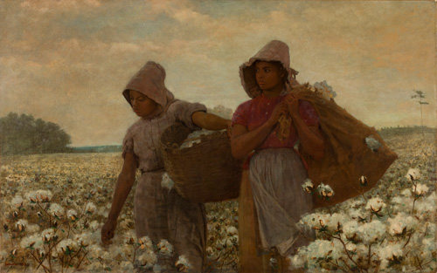
The Cotton Pickers
Winslow Homer, 1876

